Slide 1




Reducing hallucinated
transcripts in Whisper
via hallucination space
projection
Maryam Abbasihafshejani · Murtuza Jadliwala
The University of Texas at San Antonio
arXiv:2609.04561v1 [cs.AI] · 3 Sep 2026
Presented by: Nongmaithem Hans · Ravikant Sharma · AI553
Speech and Audio Processing, IIT Ropar · November 2026
Notes:
Title slide. The animated lines show noisy audio flattening into silence after passing the orange "projection" circle, a visual metaphor for the method.

Slide 2
Index
01
Introduction to the problem
3
02
The problem in depth
4
03
Proposed solution
6
04
The solution in depth
7
05
Results
12
06
Interpreting the results
14
07
Our contributions
15
08
Results of our contributions
17
09
Summary and end
22
2
Notes:
Agenda following the nine required sections. Numbers on the right are slide numbers.

Slide 3
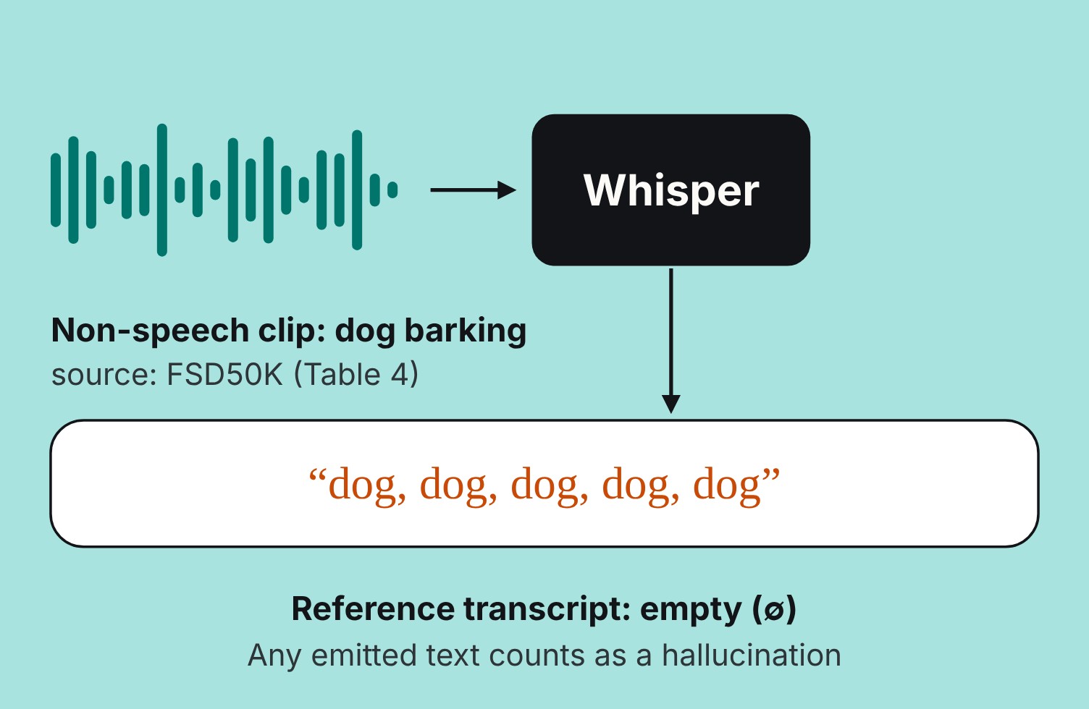
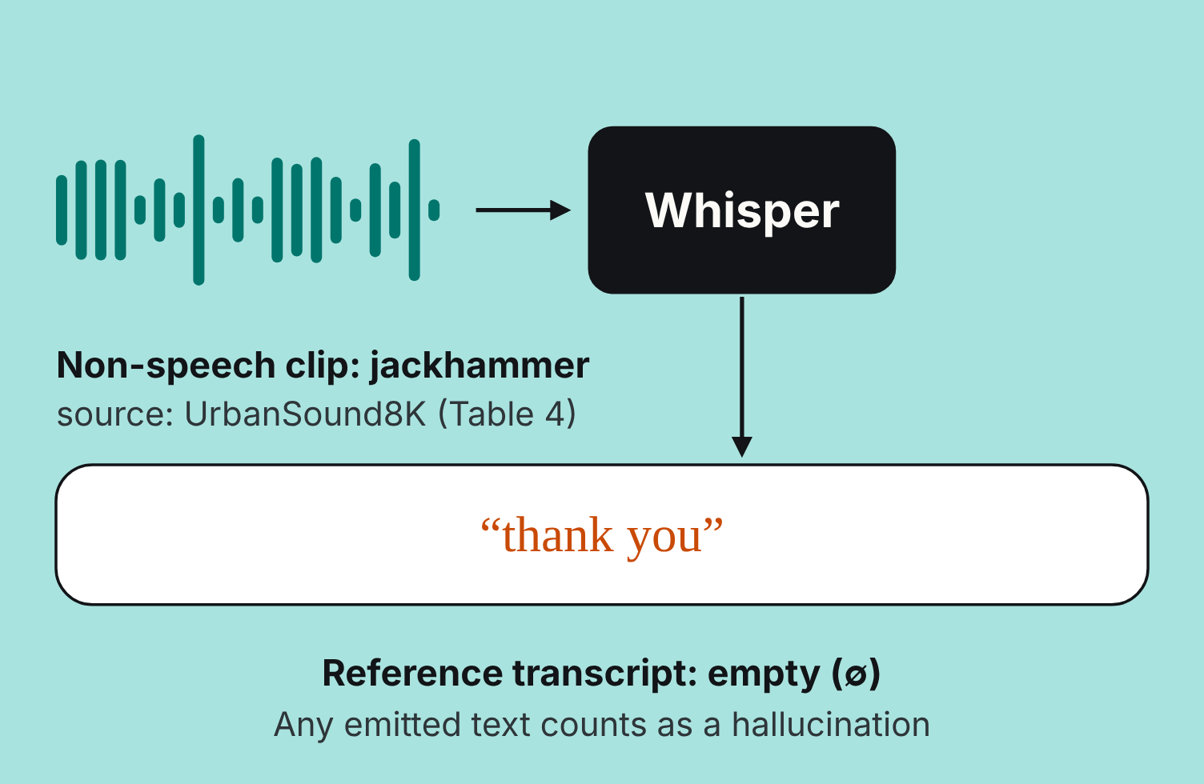
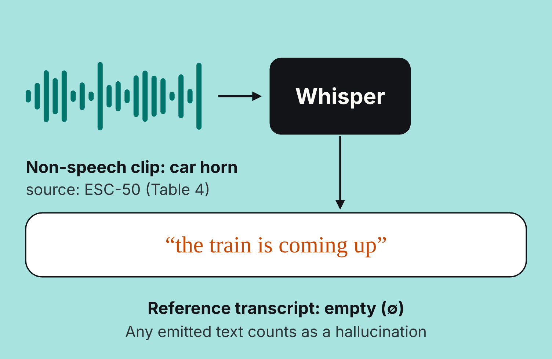
The problem: fluent text from no speech
Many audio segments (silence, music, environmental sounds,
background noise) contain no speech, so the correct
transcript is empty
A reliable ASR system transcribes speech accurately and
stays empty when there is none
Whisper (Radford et al., 2023) is a state-of-the-art, widely
used foundation model for ASR and robust speech processing
Its generative sequence-to-sequence decoder can emit fluent
text even when the input contains no speech
For non-speech audio, any generated text is a hallucination
Outputs look plausible (acknowledgments, subtitle-style
endings, conversational fillers, repeated fragments), so
downstream systems may treat them as real speech
Research question: can non-speech hallucinations be
reduced by editing Whisper's decoder activations at
inference time?
01 · Introduction to the problem
3
Notes:
Source: paper Section 1. The animation cycles three real examples from Table 4 (FSD50K dog barking, UrbanSound8K jackhammer, ESC-50 car horn): non-speech audio goes into Whisper and fluent text comes out, though the reference transcript is empty.

Slide 4
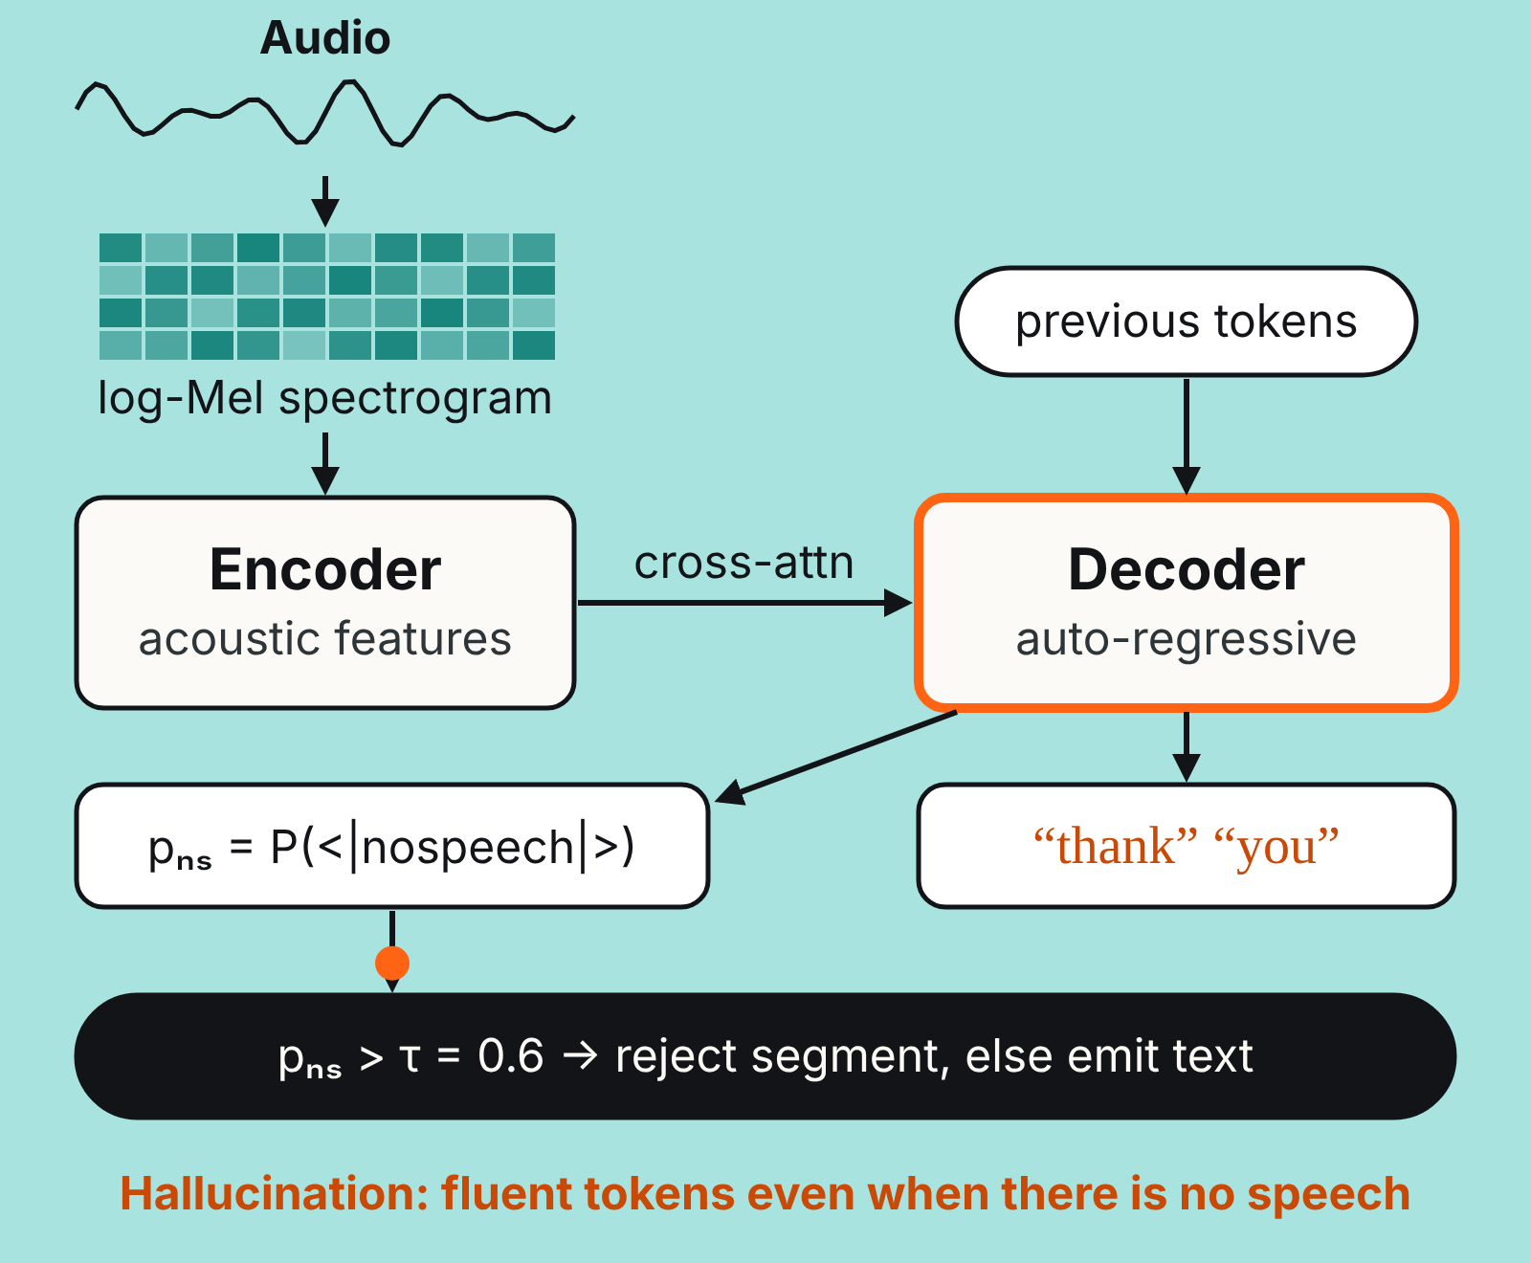
Background: how Whisper works
Transformer encoder–decoder trained on 680K hours of weakly
supervised multilingual, multitask audio; strong zero-shot
performance across languages, domains and acoustic conditions
Encoder maps audio to acoustic representations; the auto-
regressive decoder generates text conditioned on the audio and
previous tokens
Transcription and no-speech estimation share the same decoder:
there is no separately trained speech activity detector
The decoder gives a probability to the special no-speech token
<|nospeech|>, reported as no_speech_prob (p_{ns} in this deck)
Rejection heuristic: if p_{ns} exceeds threshold τ (default 0.6), the
segment is rejected as non-speech
Failure mode: decoding is generative, so the model can still give
high probability to fluent token sequences when acoustic
evidence is weak or absent
02 · The problem in depth
4
Notes:
Source: Sections 1 and 2.1. The animation follows a signal through Whisper: audio, log-Mel spectrogram, encoder, cross-attention, decoder, next token, plus the no-speech branch that checks pₙₛ against τ. The decoder emitting "thank you" from no speech is where hallucination enters. One decoder does both jobs, which is why intervening on its activations can affect both.

Slide 5
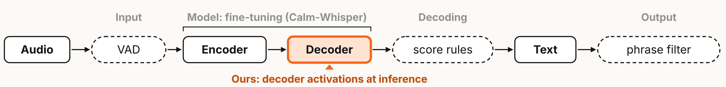
Existing mitigations: where each one acts
Input · VAD
Model · fine-tuning
Decoding · heuristics
Output · filtering
WhisperX (Bain et al., 2023)
removes non-speech regions
before decoding
Calm-Whisper (Wang et al.,
2025) trains hallucination-related
decoder parts on non-speech
audio with empty transcripts
Thresholds on no-speech
probability, log probability,
compression ratio (Radford et al.,
2023)
Bag of Hallucinations (Barański
et al., 2025) removes known
phrases after decoding
Limit: needs an external
segmentation model
Limit: misses unseen
hallucinations; can remove valid
speech
Limit: extra training; may overfit
to its data
Limit: act only on output-level
scores
Gap: none of these edit decoder activations at inference time. Hidden-state interventions already reduce hallucinations in LLMs and vision-
language models (Yang et al., 2025; Dastmalchi et al., 2026).
02 · The problem in depth
5
Notes:
Source: Section 2.3. The animated pipeline highlights where each family of methods intervenes: input (VAD), model weights (fine-tuning), decoder activations (this paper), decoding scores (heuristics), output text (phrase filtering). This paper is the only one acting on decoder activations, with no external VAD, no phrase list and no parameter updates.

Slide 6
Proposed solution: gated low-rank decoder projection
Training-free, at inference time: no parameter updates, no external VAD, no phrase lists. Key idea: hallucination-prone non-speech
behaviour lives in a low-rank subspace of decoder hidden states that can be projected away.
01
02
03
04
Calibrate
Estimate
Project
Gate
Collect decoder hidden
states for non-speech
clips that hallucinate vs.
clips correctly left empty
SVD of their differences
gives the top-r
directions: the
hallucination subspace,
then kept fixed
At one decoder layer,
remove each hidden
state's component along
that subspace (strength
α)
Apply it only when
Whisper's own no-
speech probability is at
least γ
Two variants: always-on (projection on every input) and gated (only when Whisper predicts likely non-speech)
Why the decoder: it both generates text and provides the no-speech evidence, so the method acts before tokens are emitted
03 · Proposed solution
6
Notes:
Source: Section 3 overview. Each of the four steps gets its own animated slide in the next section.

Slide 7
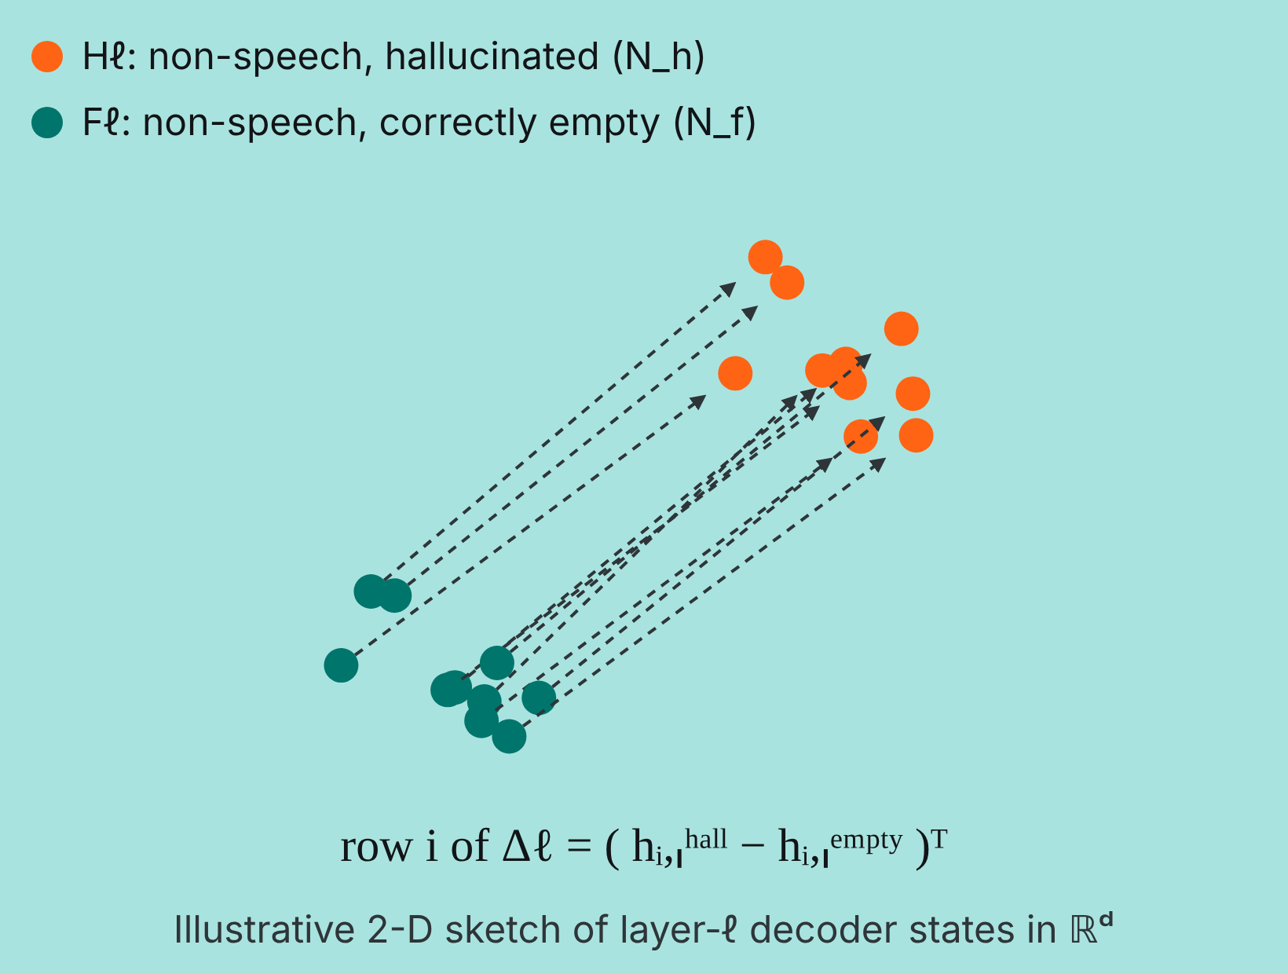
Step 1: calibration activations
Let ℓ be a decoder layer and d its hidden-state dimension. A
non-speech calibration set gives two groups of layer-ℓ
decoder hidden states:
Hℓ = { h_{i},_{l}^{hall} }, i = 1 … N_h
Fℓ = { h_{j},_{l}^{empty} }, j = 1 … N_f
h_{i},_{l}^{hall} , h_{j},_{l}^{empty} ∈ ℝ^{d}
Hℓ: non-speech inputs where Whisper produces a non-empty,
hallucinated transcript (N_h examples)
Fℓ: non-speech inputs correctly rejected, with no transcript (N_f
examples)
Estimated only from the calibration set (ESC-50 folds 1–3), then
kept fixed
04 · The solution in depth
7
Notes:
Source: Sections 3.1 and 4.1. The animation shows the two groups of hidden states (orange = hallucinated, teal = correctly empty), then pairs them up. Each dashed arrow is one row of the difference matrix used on the next slide; the arrows point the same general way, which is what makes a low-rank subspace possible. The 2-D picture is only a sketch: the real states live in ℝᵈ.

Slide 8
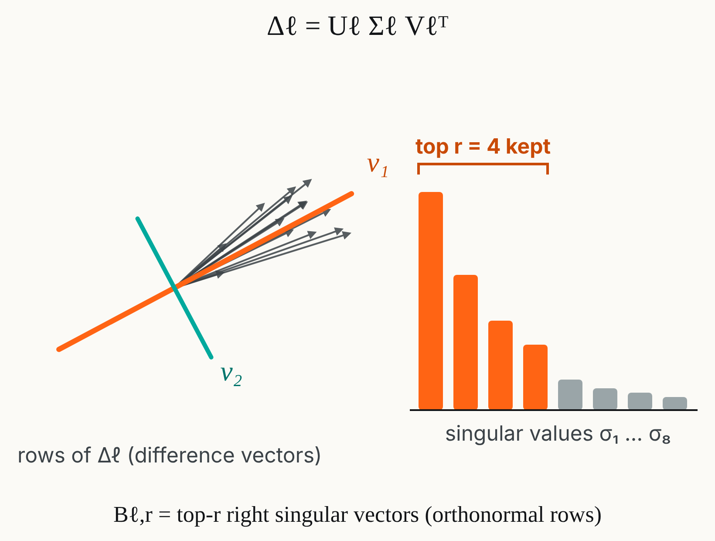
Step 2: low-rank subspace estimation
Both groups are non-speech, so differencing cancels shared acoustic
factors and keeps the hallucination-related behaviour.
1 · Difference matrix, with n = min(N_h, N_f):
Δℓ ∈ ℝ^{nxd}, row i = ( h_{i},_{l}^{hall} − h_{i},_{l}^{empty} )^{T}
2 · SVD: the right singular vectors with the largest singular values are
the dominant directions where the groups differ
Δℓ = Uℓ Σℓ Vℓ^{T}
3 · Keep the top r as a row-orthonormal projection basis; rank r sets the
dimension of the removed subspace
Bℓ,r = Vℓ,1:r^{T} ∈ ℝ^{rxd}
04 · The solution in depth
8
Notes:
Source: Section 3.2. Animation: the difference vectors (rows of Δℓ) cluster along a few directions; SVD finds them (v₁, v₂ shown in 2-D), and the singular-value spectrum shows why a small rank r suffices: keep the top r, discard the rest. The singular values drawn are illustrative, not from the paper; r = 4 is the large-v3 setting.

Slide 9
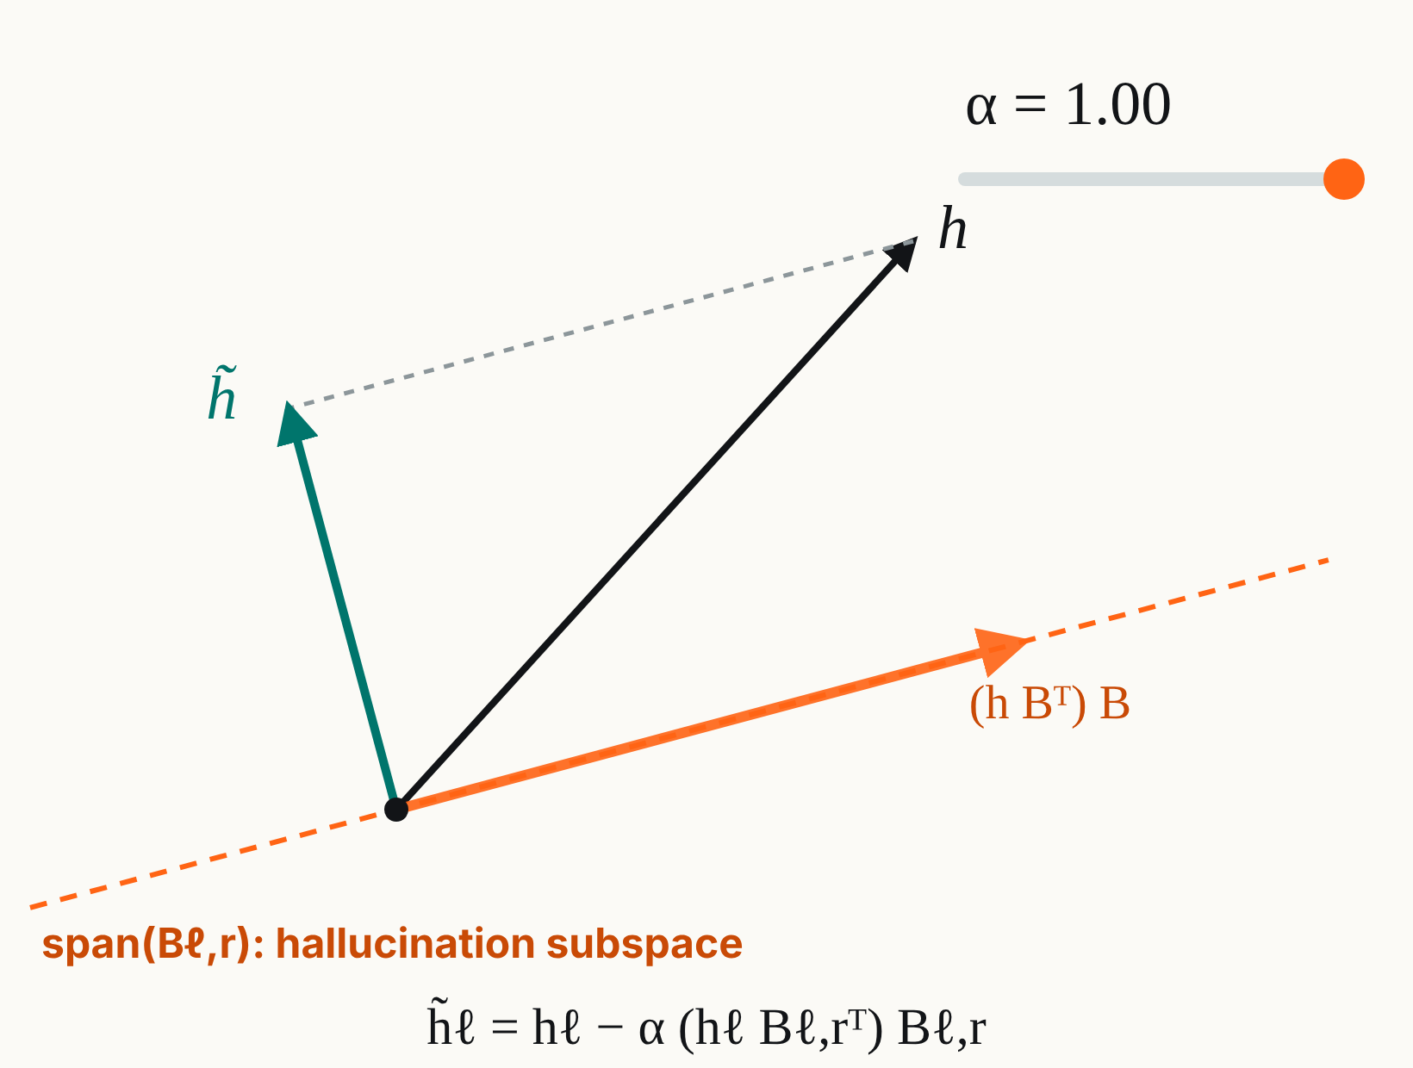
Step 3: inference-time decoder projection
A forward hook at the selected decoder layer replaces each hidden
state hℓ ∈ ℝ^{d}:
h̃ℓ = hℓ − α ( hℓ Bℓ,r^{T} ) Bℓ,r (1)
hℓ Bℓ,r^{T}
coordinates of hℓ along the r hallucination directions
( hℓ Bℓ,r^{T} ) Bℓ,r
the component of hℓ inside the hallucination
subspace
α
projection strength; with orthonormal rows, α = 1
removes the component fully, smaller α removes
part of it
Intuition: remove the directions that make non-speech inputs
produce text, and keep the information normal transcription needs
No change to model parameters or to the decoding procedure
04 · The solution in depth
9
Notes:
Source: Section 3.3, Equation (1). Animation: h (black) is split into its component along the hallucination subspace (orange) and the rest. As α slides from 0 to 1, h̃ (teal) moves from h to the part orthogonal to the subspace. The remark that α = 1 is a full orthogonal projection follows from the rows of B being orthonormal; the paper itself only calls α the projection strength.

Slide 10
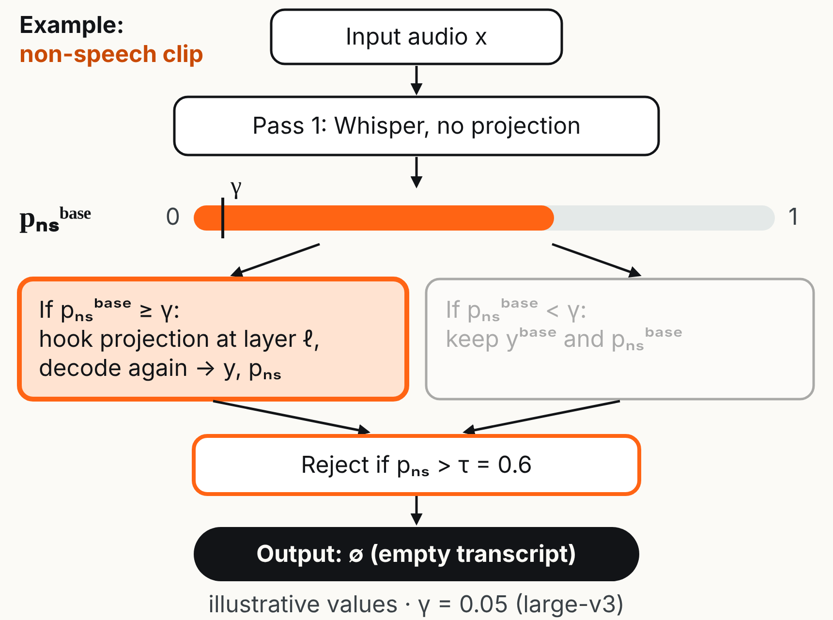
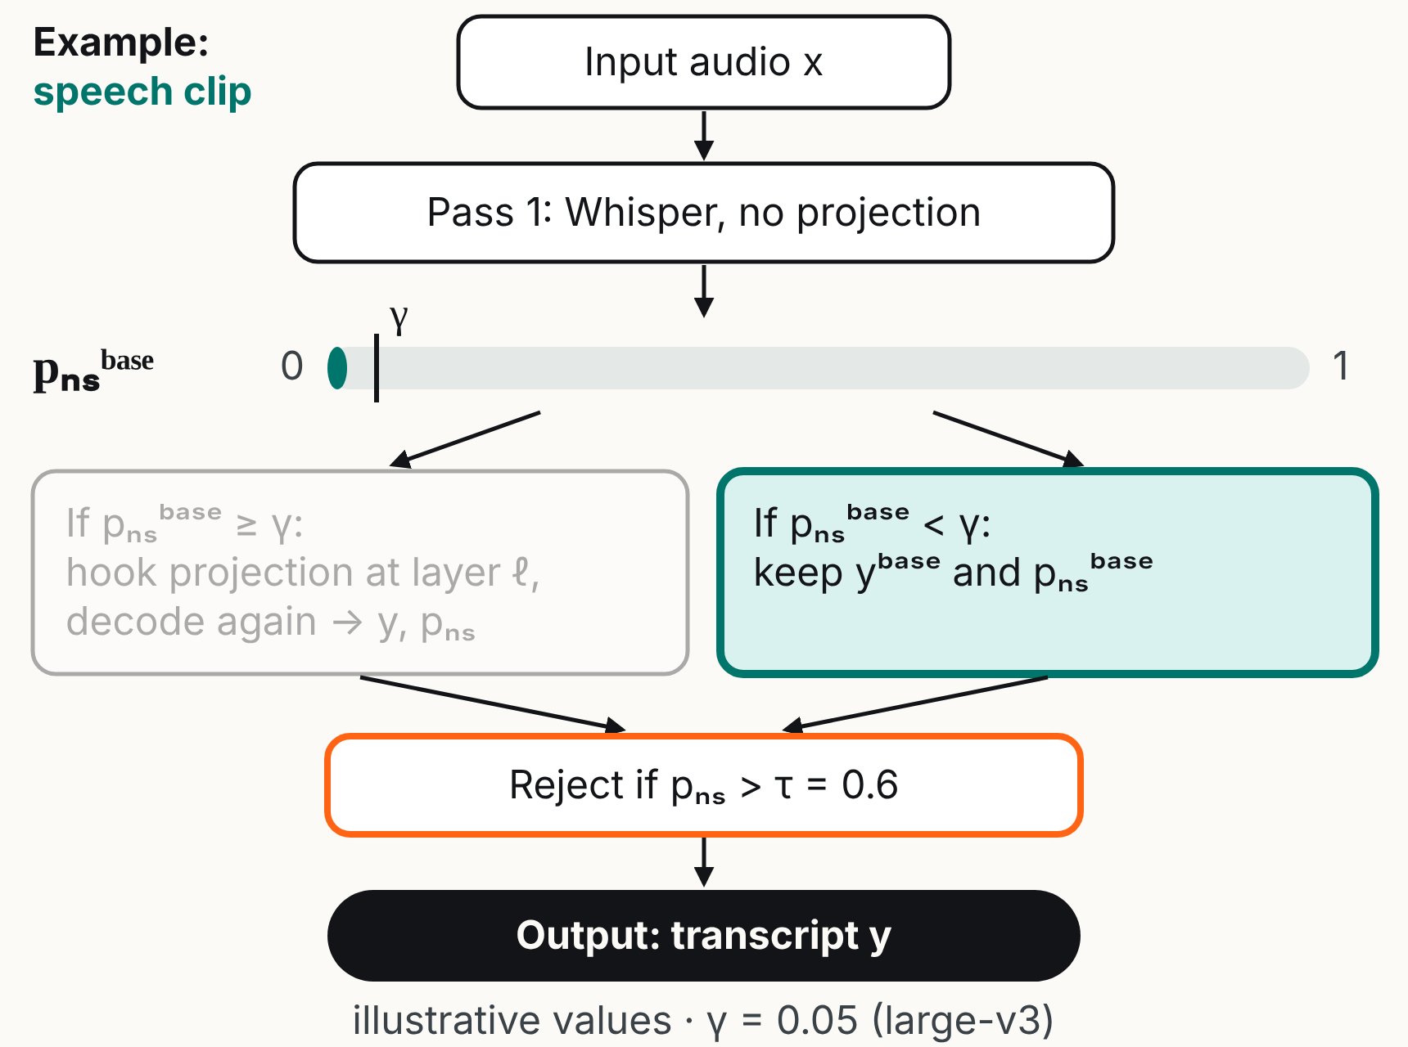
Step 4: no-speech-conditioned gating
Eq. (1) on every input can perturb real speech, so it is applied only
when Whisper's own no-speech estimate is high
p_{ns}^{base} = no-speech probability from a first, unprojected pass; γ =
gate threshold
h′ℓ = hℓ − α ( hℓ Bℓ,r^{T} ) Bℓ,r if p_{ns}^{base} ≥ γ
h′ℓ = hℓ if p_{ns}^{base} < γ
Gate open: decode again with the projection; otherwise keep the
unprojected output
The resulting p_{ns} is then compared with τ for the final rejection
decision
γ decides WHEN the
activation intervention is
applied
τ decides WHETHER the
segment is rejected (default
0.6)
04 · The solution in depth
10
Notes:
Source: Section 3.4. The animation alternates two cases. A non-speech clip has a high pₙₛᵇᵃˢᵉ, so the gate opens, the projection is applied, pₙₛ rises above τ and the output is empty. A speech clip has pₙₛᵇᵃˢᵉ below γ, so the gate stays closed and the normal transcript is kept. Gauge levels are illustrative; γ = 0.05 is the selected large-v3 value. In the official code, the no-speech token probability is exposed as no_speech_prob.

Slide 11
Evaluation: metrics and parameters
HR
WER
FRR
Hallucination rate: non-speech inputs
whose output is still non-empty after no-
speech filtering (reference is empty)
Word error rate on LibriSpeech, the cost
to real transcription
False rejection rate: fraction of speech
samples wrongly rejected by the no-
speech filter
Four parameters, one forward hook on one decoder layer
ℓ
r
α
γ
decoder layer
rank of the subspace
projection strength
gate threshold
Whisper's default no-speech threshold τ = 0.6 throughout. Parameters are chosen per Whisper scale (different depth and hidden
size), once, on ESC-50 folds 1–3 plus LibriSpeech validation-clean (only to control speech degradation), then fixed for every held-out
evaluation.
04 · The solution in depth
11
Notes:
Source: Section 4.2. Emphasize that no test data is used to tune parameters.

Slide 12
Result 1: non-speech hallucination rate (HR, %)
Model | Method | ESC-50 | UrbanSound8K | FSD50K
Small | Original | 23.50 | 12.33 | 21.35
 | Always-on | 1.50 | 0.81 | 6.68
 | Gated | 1.53 | 0.84 | 6.84
Medium | Original | 26.50 | 14.52 | 41.95
 | Always-on | 1.82 | 0.62 | 8.02
 | Gated | 2.75 | 0.66 | 8.78
Large-v3 | Original | 44.25 | 76.08 | 21.35
 | Always-on | 1.50 | 0.87 | 0.18
 | Gated | 8.38 | 2.74 | 1.15
ESC-50 = held-out folds 4–5 · Whisper no-speech threshold τ = 0.6 · lower is better
05 · Results
12
Notes:
Source: Table 1. Check: the small-model and large-v3 FSD50K "Original" values are both 21.35 in the paper; the large-v3 value matches Table 8 and Fig. 4.

Slide 13
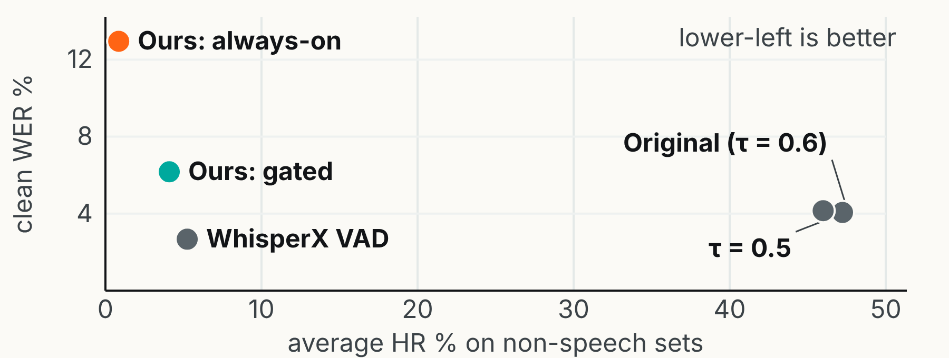
Versus baselines: the full trade-off
Threshold tuning alone barely moves HR (47.23% → 45.99%)
WhisperX keeps the best speech quality, but needs an
external VAD and segmentation stage
Gated lowers average HR further with no external detector,
at a modest WER and FRR cost; always-on gives the lowest
HR at a larger cost
Method (large-v3) | Avg HR | Clean WER | Other WER | Clean FRR | Other FRR
Original (τ = 0.6) | 47.23 | 4.06 | 5.87 | 0.04 | 0.00
Threshold tuning (τ = 0.5) | 45.99 | 4.15 | 5.87 | 0.08 | 0.00
WhisperX VAD | 5.24 | 2.67 | 4.74 | 0.00 | 0.00
Gated projection | 4.09 | 6.17 | 6.57 | 2.86 | 1.40
Always-on projection | 0.85 | 12.95 | 13.13 | 10.50 | 11.47
05 · Results
13
Notes:
Source: Section 5.4, Tables 2, 3 and 8. Avg HR is the mean over ESC-50 (folds 4–5), UrbanSound8K and FSD50K. The animated scatter puts every method on one plane: hallucination (x) against clean WER (y). WhisperX and gated projection both reach the lower-left region; gated does it without an external detector.

Slide 14
What it means: the hallucination results
01
Hallucination is low-rank. A fixed subspace of 1 to 4 directions at one decoder layer pushes non-speech inputs over the
rejection threshold.
02
It transfers across datasets. Calibrated on ESC-50 folds 1–3 and tested on folds 4–5, UrbanSound8K and FSD50K,
which suggests a reusable decoder-level signature, not ESC-50-specific acoustics.
03
Depth matters most, rank saturates. Early layers are weak, middle-to-late layers strong; more directions are not better
and can remove speech-relevant information.
04
The baseline problem is severe. Original large-v3 hallucinates on 76.08% of UrbanSound8K clips: 0.87% always-on,
2.74% gated.
05
Always-on vs. gated. Always-on gives the lowest HR; gated is slightly higher on large-v3 (8.38% vs 1.50% on ESC-50)
but protects speech. For small they are nearly identical (1.53% vs 1.50%).
06 · Interpreting the results
14
Notes:
Source: Sections 5.1 and 5.2 discussion.

Slide 15
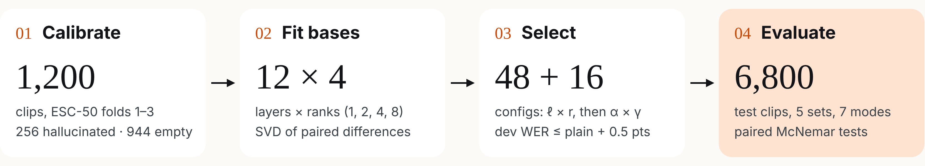
Our contributions: reproduce, then test it
Setup
Four contributions
Whisper small, fp16, on an RTX 3050 6 GB laptop GPU; about 3
hours end to end
Reproduction on Whisper small, including the paper's own operating
point
Greedy decoding, English forced, 30 s window; reject when
p_{ns} > τ = 0.6
Threshold baseline the paper omits: τ chosen on dev by the paper's
own rule, compared clip by clip
Seeded test subsets: 800 ESC-50, 2,000 UrbanSound8K, 2,000
FSD50K, 1,000 + 1,000 LibriSpeech
Analysis of what the gate and the edit do, and why the last layer fails
Affine variant: move states to the empty-class mean instead of zero
07 · Our contributions
15
Notes:
Source: our report (Hans and Ravikant Sharma), Sections I and IV. Selection: 48 always-on configs (12 layers × ranks 1, 2, 4, 8, α = 1), then 16 gated configs (α × γ), on 400 calibration clips and 200 LibriSpeech dev-clean utterances, run once for Eq. (1) and once for the affine Eq. (2). Runtime: about 1 hour for Eq. (1) and the baselines, 2 hours for the affine variant.

Slide 16
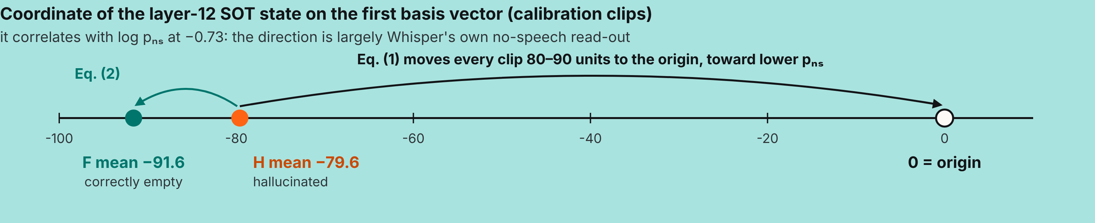
Why the last layer fails: and our affine fix
Paper, Eq. (1): project to zero
Ours, Eq. (2): move to the empty-class mean
h̃ = h − α (h B^{T}) B
h̃ = h − α ((h − c) B^{T}) B
At layer 12, clips with p_{ns} > 0.6 drop from 78.7% to 0% at
every rank: nothing is rejected, so HR is 100%
c = mean of the F states at layer ℓ. Clips with p_{ns} > 0.6 rise
from 78.7% to 95.2% (r = 1) and 99.4% (r = 8)
07 · Our contributions
16
Notes:
Source: our report, Sections III-C and V-F. The last block's output goes straight to the final LayerNorm and output embedding, so pₙₛ can be recomputed from the saved calibration states with and without the edit (matches saved values within 0.004). Calibration labels are defined by pₙₛ, so the H-vs-F direction is largely the no-speech read-out. Both groups sit far from zero on it, so Eq. (1) is not a neutral removal. Eq. (2) changes only the target of the edit; B, the gate and selection stay the same. Linear concept erasure is optimal when affine (LEACE, Belrose et al. 2023).

Slide 17
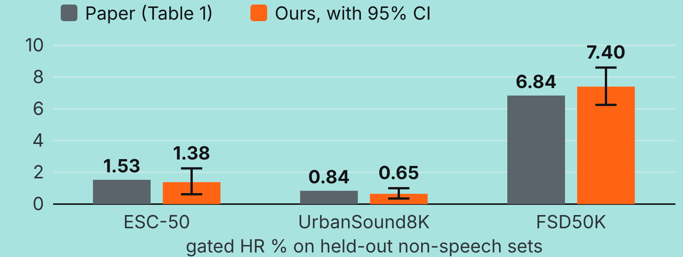
Reproduction: the paper's own setting on Whisper small
HR reproduces: gated mean 3.14% against the published
3.07%; all six values inside our 95% CIs
Gated speech cost is close: WER +0.60 / +0.78 points over
plain Whisper, against the paper's +0.33 / +0.75
Always-on does not: FRR 6.7% / 14.7% against 0.64% /
4.86%, so 4–10× more speech is lost
ℓ = 10, r = 1, α = 1, γ = 0.15 | HR ESC-50 | HR US8K | HR FSD50K | WER clean | WER other | FRR clean | FRR other
Original · paper | 23.50 | 12.33 | 21.35 | 4.04 | 8.38 | 0.00 | 0.00
Original · ours | 26.12 | 14.50 | 44.60 | 3.31 | 7.63 | 0.00 | 0.00
Always-on · paper | 1.50 | 0.81 | 6.68 | 4.51 | 11.48 | 0.64 | 4.86
Always-on · ours | 1.38 | 0.55 | 7.10 | 8.20 | 19.49 | 6.70 | 14.70
Gated · paper | 1.53 | 0.84 | 6.84 | 4.37 | 9.13 | 0.41 | 2.58
Gated · ours | 1.38 | 0.65 | 7.40 | 3.91 | 8.41 | 1.40 | 2.40
08 · Results of our contributions
17
Notes:
Our run with the paper's published small setting (Section 5.1, Table 1–3 rows for small). Bars: gated HR, paper vs ours, whiskers = our 95% bootstrap CI. Bold cells are where we disagree with the paper. Our FSD50K baseline (44.60%) is twice the paper's 21.35%, which equals the paper's large-v3 value. Test sets are seeded subsets (see previous slide), so plain-Whisper WER differs slightly from the paper's.

Slide 18
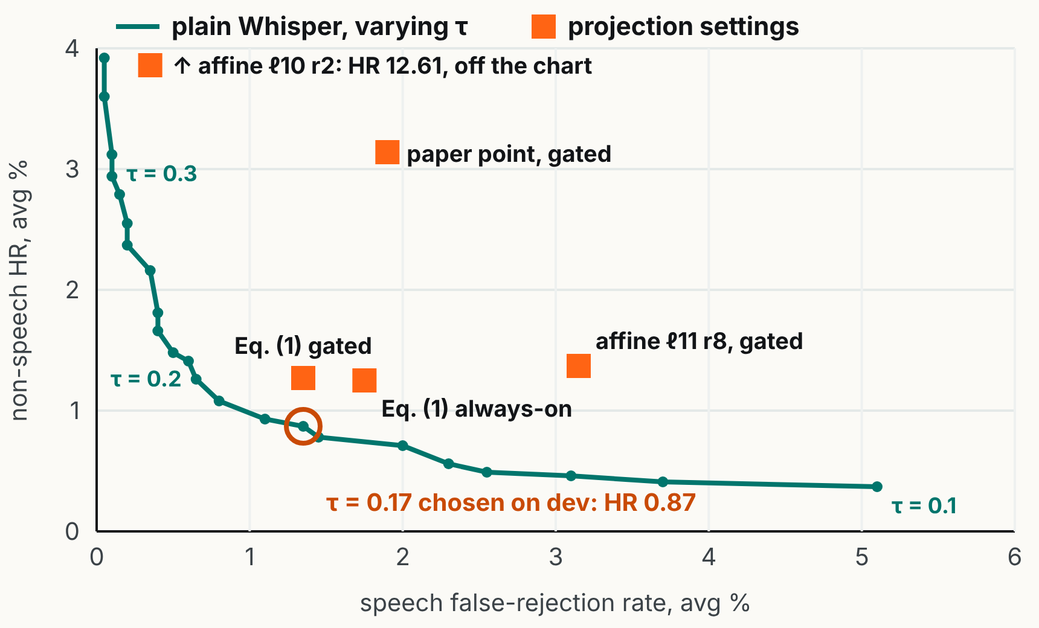
A tuned threshold: matches or beats the projection
Held-out, Whisper small | HR | WER | FRR
Plain, τ = 0.6 | 28.41 | 5.47 | 0.00
Plain, τ = 0.17 (dev) | 0.87 | 5.93 | 1.35
Gated, Eq. (1) ℓ11 r8 | 1.27 | 6.58 | 1.35
Gated, paper point | 3.14 | 6.16 | 1.90
Gated, affine ℓ10 r2 | 12.61 | 5.68 | 0.35
Same selection rule, a τ grid of step 0.01: on dev, τ = 0.17 gives HR
0% at unchanged WER
No projection lies below or left of the threshold curve
p_{ns} already separates speech from non-speech: AUROC 0.9991
plain, 0.9986 gated
The paper's τ sweep stops at 0.5
08 · Results of our contributions
18
Notes:
Source: our report, Section V-C, Table III and Fig. 3. Averages: HR over ESC-50 folds 4–5, UrbanSound8K and FSD50K; WER and FRR over LibriSpeech test-clean and test-other. τ = 0.14–0.17 tie on dev (HR 0%, WER 3.59%); we take the largest. Within the tie the choice matters little: τ = 0.15 gives HR 0.71%, WER 6.18%, FRR 2.0%. The threshold is lower or equal on all three metrics against our tuned Eq. (1) setting.

Slide 19
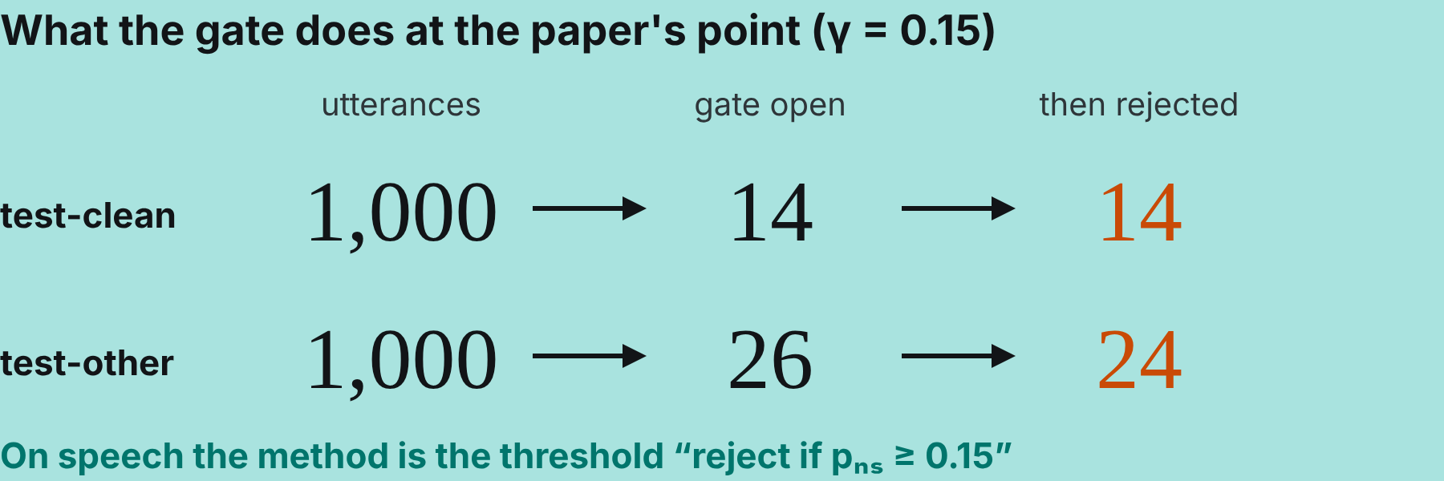
At equal HR: projection rejects more speech
Paired test vs plain Whisper at the same HR | Speech rejected (proj. / τ) | McNemar p | Hallucinated (proj. / τ) | p | Avg WER diff [95% CI]
Gated Eq. (1) ℓ11 r8 vs τ = 0.2 | 24 / 10 | 0.024 | 45 / 46 | 1.0 | +0.95 [0.40, 1.56]
Gated, paper point vs τ = 0.3 | 36 / 0 | 3·10⁻¹¹ | 91 / 91 | 1.0 | +0.68 [0.40, 0.99]
Gated affine ℓ10 r2 vs τ = 0.46 | 7 / 0 | 0.016 | 192 / 169 | 0.25 | +0.21 [0.06, 0.41]
Same as plain τ = 0.15
WER 3.91 / 8.45, FRR 1.4 / 2.6, against 3.91 / 8.41 and 1.4 / 2.4,
with lower HR (0.71% vs 3.14%)
The cost is rejection only
On projected, accepted utterances WER barely moves (4.55 →
4.65 clean); rejected ones are short (9.1 vs 20.2 words)
08 · Results of our contributions
19
Notes:
Source: our report, Sections V-D and V-E, Table IV. Both methods run on the same clips: exact McNemar test on clips only one method gets wrong, paired bootstrap over utterances (2,000 resamples) for WER. Each projection is compared with plain Whisper at the τ that gives the same held-out HR. With our γ = 0.05 the gate opens for 99.9% of non-speech clips, so gated is effectively always-on there; on speech it opens for 149 and 207 utterances and keeps all but 2 and 25. WER on projected and accepted utterances: 4.55 → 4.65 (test-clean, n = 147), 10.80 → 10.49 (test-other, n = 182). Rejected utterances at the paper's point average 9.1 and 7.4 words, against 20.2 and 18.2 overall.

Slide 20
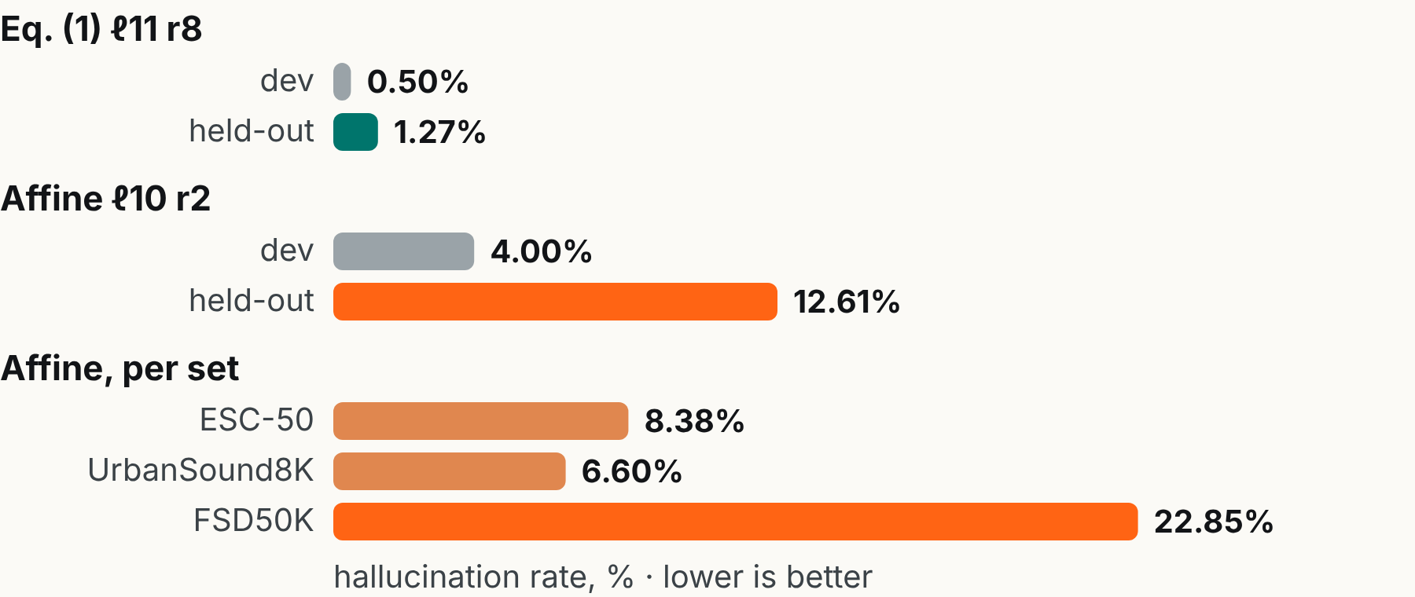
Affine variant: keeps speech, misses new sounds
Keeps speech: FRR 0.35% and WER 5.68%, against 1.35%
and 6.58% for Eq. (1)
Generalises poorly: held-out HR 12.61% against 4.0% on
dev; FSD50K sound classes are not in ESC-50
Still loses to a threshold: at equal HR (τ = 0.46) it rejects 7
utterances, the threshold 0 (p = 0.016)
Why it breaks at other settings
A side effect we do not count
c is the mean at the SOT position, but the hook edits every position.
At ℓ11 r8 the decoder emits only “<|zh|><|zh|>…”: WER 99.6% on
edited utterances
Always-on affine lowers test-clean WER 3.31 → 2.92 (−0.39 [−0.77,
−0.09]) but not test-other (+0.24 [−0.17, 0.69])
08 · Results of our contributions
20
Notes:
Source: our report, Section V-G and Table III. Selected affine setting: ℓ = 10, r = 2, α = 1, γ = 0.05 (dev HR 4.0%, WER 3.89%). Only three affine settings kept dev WER within 0.5 points; at most others the transcripts are destroyed without being rejected. Against the dev-chosen τ = 0.17 the threshold is far better on hallucinations (0.87% vs 12.61%) but rejects more speech (24 vs 4, p = 1.8·10⁻⁴); the WER difference is not significant. The Eq. (1) setting moved much less from dev to test (0.5% to 1.27%). Natural next step, untested: a per-position centre, or editing only the SOT position.

Slide 21
What this means: issues in the paper's evaluation
1
The key control is missing. The τ sweep stops at 0.5,
though the paper's own medium ablation shows plain HR
29.49% → 13.08% from τ 0.6 to 0.4
5
Labels come from p_{ns}, so the subspace partly re-learns the
no-speech read-out, consistent with unchanged AUROC
6
Tuning ignores noisy speech: our Eq. (1) setting had 0%
FRR on dev-clean but 2.5–3.3% on test-other
2
At the published small setting the edit adds nothing on
speech: every gated utterance is rejected
7
Internal inconsistencies: validation WER 3.94% vs 11.59%,
medium α 0.75 vs 1.0, FSD50K 21.35% for two models, the
FSD50K count
3
WER mixes two errors. On accepted utterances the edit
does no harm; the whole cost is rejecting short utterances
4
Projecting to zero is not neutral. An affine target fixes the
last layer, but one SOT centre at every position breaks
decoding
Limits of our study: Whisper small only, one seed, held-out
subsets, no WhisperX VAD run
08 · Results of our contributions
21
Notes:
Source: our report, Sections VI and VII. Issue 7 in full: Fig. 1 and Sec. 5.1 give different validation WER (3.94% vs 11.59%); medium α is given as 0.75 and 1.0; plain FSD50K HR is 21.35% for both small and large-v3; Table 5 at τ = 0.6 disagrees with Table 1 for medium (plain HR 29.49% vs 27.66%); the FSD50K count fits removing speech but not music; Calm-Whisper is compared under a different HR definition. Also from the report: Wilson intervals show WhisperX VAD beats gated projection on ESC-50 (4.13% vs 8.38%) and ties on UrbanSound8K. Medium and large-v3 need a larger GPU, so the threshold comparison should be repeated there.

Slide 22
In summary: seven things to remember
Problem
Whisper hallucinates fluent text on non-speech audio (large-v3: non-empty on 44.25% of ESC-50 and 76.08% of
UrbanSound8K clips)
Method
Training-free, low-rank decoder activation projection, calibrated once on non-speech data and fixed, optionally gated
on Whisper's own no-speech probability
Results
Average HR 31.31% → 2.44% (always-on) and 3.74% (gated): relative reductions of 92.21% and 88.05%
Cost
Gated WER +0.33 to +4.39 points and FRR 0.41% to 9.97%; the HR–WER–FRR trade-off is controllable through τ, γ
and α
Vs. baselines
Large-v3 gated average HR 4.09% beats WhisperX VAD (5.24%), BoH (44.09%) and threshold tuning (45.99%), with
no external detector, phrase list or fine-tuning
Our reproduction
On Whisper small the paper's HR reproduces (3.14% vs 3.07%), but plain Whisper with τ = 0.17 chosen on dev does at
least as well (HR 0.87%, WER 5.93%, same FRR); at equal HR every projection rejects more speech
Our affine variant
Moving states to the empty-class mean fixes the last-layer failure and nearly removes false rejections, but it
generalises poorly (held-out HR 12.61%)
09 · Summary and end
22
Notes:
Source: Abstract, Sections 5 and 6; the last two rows come from our own reimplementation (section 08).

Slide 23

Thank you
Questions?
Reducing Hallucinated Transcripts in Whisper via
Hallucination Space Projection · arXiv:2609.04561v1
Notes:
Closing slide.

